Slide 1

Safely Evolving Legacy Code
Slides up at scottsauber.com
scottsauber

Slide 2

Audience
Anyone maintaining legacy code
Poll
How many people maintain legacy code?
How many people enjoy it?
scottsauber

Slide 3
Agenda
What is Legacy Code
Options for making changes to Legacy Code
Process for safely doing so
How I’ve evolved legacy code with real world applications
scottsauber

Slide 4
Goals
Give you ideas on how you can safely work with legacy code today
This is not about how to completely rewrite your app, this is about evolving
scottsauber

Slide 5


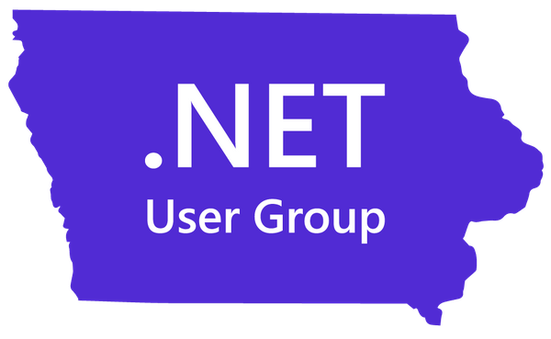
Who am I?
Director of Engineering at Lean TECHniques
Microsoft MVP
Co-organizer of Iowa .NET User Group
Dometrain Author
Blog at scottsauber.com

Slide 6

“Legacy Code is code
without tests.”
Michael Feathers

Slide 7

“Legacy Code is valuable code we’re afraid to change.”
JB Rainsberger

Slide 8
Characteristics of Legacy Code
Hard to understand
Changing code often breaks the app in unexpected ways
Long cycle times to add or change functionality
Huge estimates for seemingly small changes
Stories seemingly drag on across days, weeks, months
3rd party brought in for assessment
scottsauber

Slide 9
A JIRA issue gets created…
…for “that app”

Slide 11
3 options when changing legacy code
Edit and Pray
The Great Rewrite To Solve All Our Problems™️
Cover and Modify
scottsauber

Slide 12
Question to ask yourself:
How much time do you have?

Slide 13
Answer 1:
I need to add this new functionality today!

Slide 14
I need to add new functionality today!
Adding “just a few more lines” to the god classes/functions is not an option
Find seams in existing code
We should not refactor without existing tests in place
Make minimal changes to untested code with one of two techniques
Sprout
Wrap
scottsauber

Slide 15

Sprout

Slide 16
Sprout
Create new method/function/class to house new behavior
TDD the new behavior
Insert new, tested code into existing code (existing code untested)
In the case of .NET you can call new C# code from old VB code
scottsauber

Slide 17
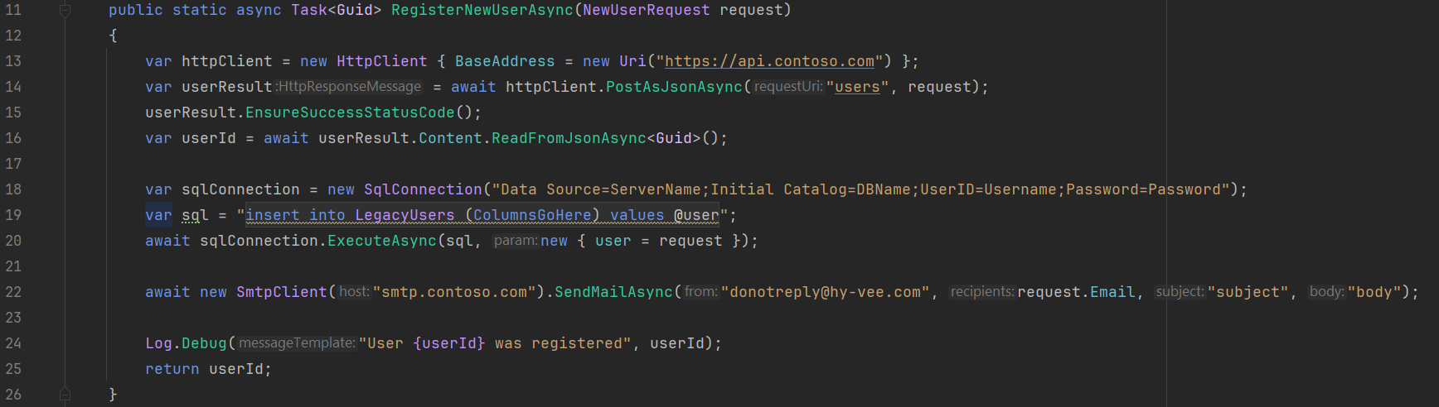

Sprout Example – Existing Code
scottsauber

Slide 18
New Requirement!
Do not allow an invalid email address to be registered

Slide 19
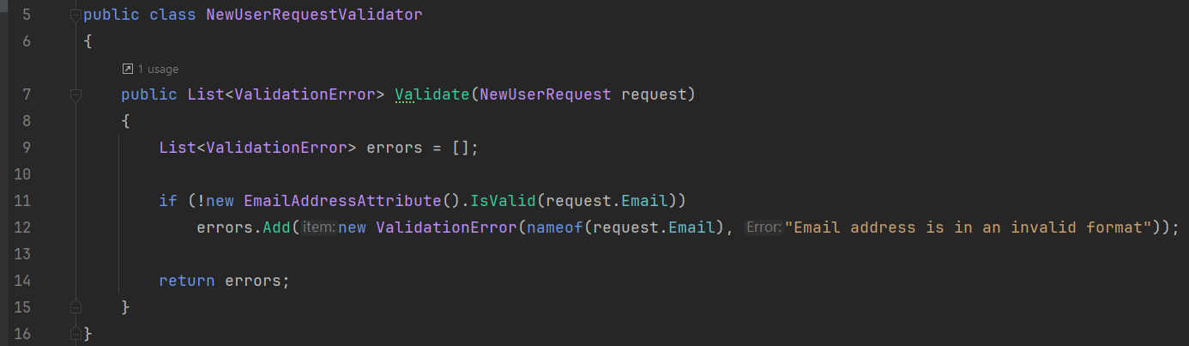
Sprout Example – New Code Tested In Isolation
*just use Fluent Validation
scottsauber

Slide 20
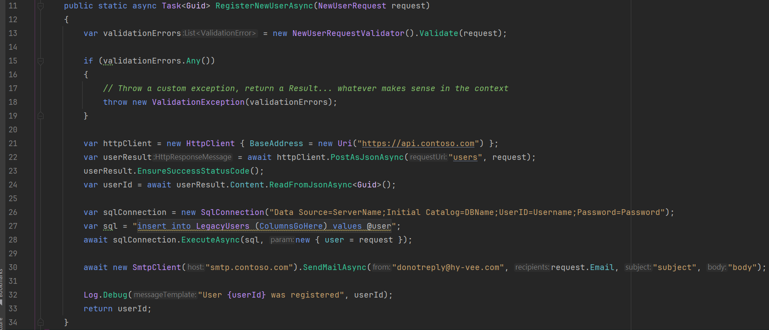
Sprout Example – Sprout into Existing Code
scottsauber

Slide 21
Sprout Takeaways
Write new code in isolation from the mess
If you keep adding to the pile of debt, the only way out is bankruptcy
Eventually over time things will get better (might take months or years)
Can even test most of the untested sprouted code in isolation!
scottsauber

Slide 22

Wrap

Slide 23
Wrap
Only works if new code needs to be added to beginning or end of existing code
Process is:
Extract all existing code into another method (safe to do with an IDE)
Call newly extracted method from the original method (also safe)
Insert new code before/after the extracted method
scottsauber

Slide 24
Wrap Example – Existing Code
scottsauber

Slide 25
New Requirement!
Do not allow an invalid email address to be registered

Slide 26
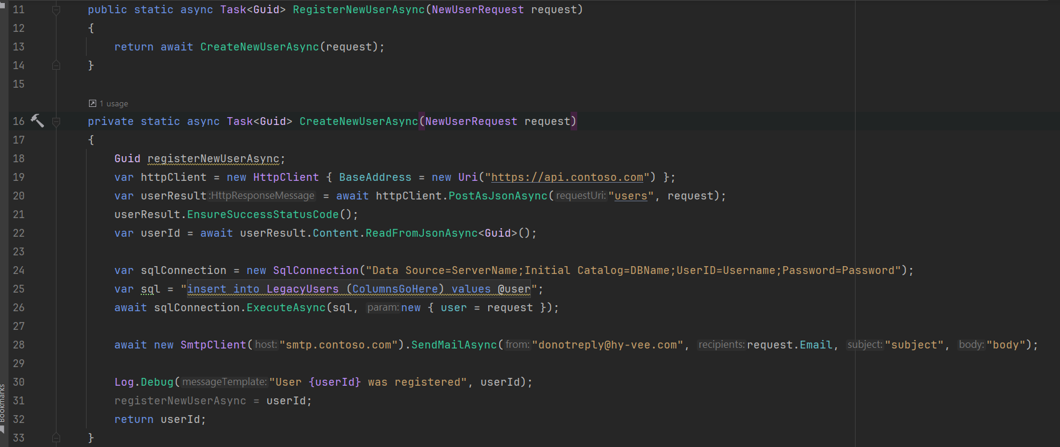
Wrap Step 1 –Extract To Private Method
scottsauber

Slide 27
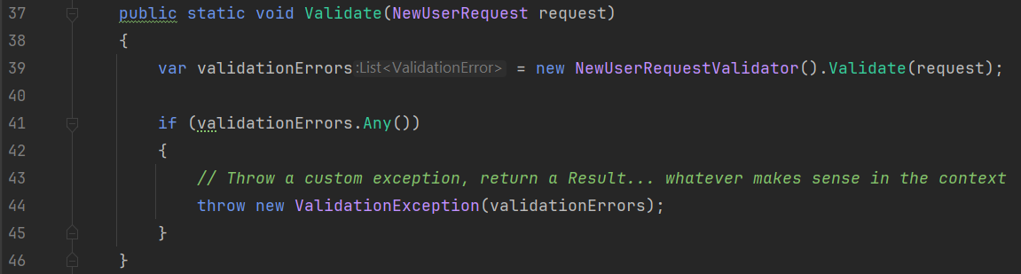
Wrap Step 2 – Create + Test New Methods
scottsauber

Slide 28
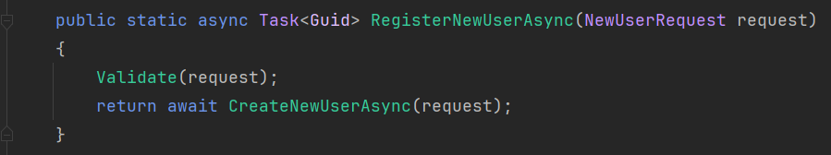
Wrap Step 3 – Call from Original Method
scottsauber

Slide 29
Wrap Takeaways
Similar to Sprout (especially this example)
Only works in some scenarios (new code added to start/end)
scottsauber

Slide 30
Sprout and Wrap Takeaways
Use these techniques when you need to make a change immediately
Sprout works always
Wrap can work when code can be added to beginning or end
scottsauber

Slide 31
Questions about
Sprout or Wrap?

Slide 32
Question to ask yourself:
How much time do you have?

Slide 33
Answer 2:
We have some extra time!

Slide 34
Avoid The Great Rewrite™️
The Great Rewrite™️ is $$ and risky especially without proper understanding of the current system
Delays new feature development
No iterative steps
Without tests, you are Editing and Praying
Don’t try to rewrite the entire app
Instead - slice off pieces
scottsauber

Slide 35
Avoid The Great Rewrite™️
…but before you carve off, understand current state
Can’t properly rearchitect without understanding current slice
I am usually not a fan of moving app logic + db schema at the same time
Move the app logic first, then move the db schema later when everything is on the new code
Avoid replicating data, whole new sets of problems
scottsauber

Slide 36
How do I evolve Legacy Code?
Get the developer ecosystem stable
Understand what the app does
Add characterization/integration tests around existing code
Refactor safely!
scottsauber

Slide 37
1. Get the Developer Ecosystem Stable
Is it in source control?
Is there a reliable CI pipeline?
Is there a reliable CD pipeline?
Can I run it locally without being pointed at Production?
Can we remove our Production access?
Is there reliable test data?
scottsauber

Slide 38
2. Understand the app
Add logging
Add metrics
Add instrumentation
Observe the app in Production
Read the code and take notes
Refactor without tests, but throw the code away when you’re done
scottsauber

Slide 39
3. Add characterization tests
After understanding the inputs and outputs, you can now add tests
Blackbox implementation code as much as possible
WebApplicationFactory is great for this in .NET
Builds up knowledge of how the code works
Need safety net when you refactor in the next step
scottsauber

Slide 40
3. Add characterization tests Paradox!
scottsauber

Slide 41
3. Add characterization tests Paradox
Paradox!
I need to add tests so I can change the code safely
I can’t test without changing the code
Make absolute bare minimum changes to allow testability
DI is your friend (constructor, method, and even property injection)
scottsauber

Slide 42
4. Refactor the Code
Now that you have tests you can safely refactor
Make change, run tests, repeat
Get back to green as quickly as possible
Avoid “long red”
Repeat until code is in good state
scottsauber

Slide 43

Real Examples

Slide 44
Legacy Code Disclaimer
Legacy code is not the fault of an individual
Code is the product of an organization not an individual
Time constraints
Technical constraints
Technical training (or lack thereof)
Allowing silos to form
Everybody does their best with the constraints they work within
scottsauber

Slide 45
Situation 1
Inherit a weekly legacy ETL process
ETL process sends data to hundreds of retail stores
When the stores don’t have this data, they can’t set accurate prices
80% of this code is SQL (including xp_cmdshell), 10% is VB, 10% is C#
Takes 40 hours to run and fails 90% of the time, needs babysat
Required 20+ hours of off-hours support from devs, every single week
Key Dev making this work left the company
Millions of dollars lost to the business not having accurate data
Tiger Team Created to fix this
scottsauber

Slide 46
1. Get The Developer Ecosystem Stable
Created CI/CD Pipelines
Got it to run locally (without pointing at Production)
Root caused issues and fixed
Avoided extending the timeout on long running stored procedures
On-call rotation of 2 to shield team from immediate production issues
scottsauber

Slide 47
2. Understand the application
Refactored w/out committing
Created tools/utilized Grafana to measure the ETL worked
Add instrumentation to understand how it performed in Production (NewRelic)
Zero domain knowledge from 90% of team members
Pair Programmed
scottsauber

Slide 48
3. Add characterization tests
Created test environment
Dockerized the databases required for local dev
Added integration tests
First test required 40K LOC of SQL across 3 databases
Created tool to autogenerate that 40K LOC so we didn’t have to maintain it
scottsauber

Slide 49
4. Refactor
Analyzed NewRelic instrumentation
Identified bottlenecks
Optimizing code now safe to make with integration tests in place
scottsauber

Slide 50
Outcomes
ETL process went from running 40hrs to 1hr
20 hours of off hours support dropped to 0
Increased developer happiness
Stores get their data faster
Code is easier to make changes
Users reported longstanding bugs rather than working around them, because they expected things to work
scottsauber

Slide 51
Situation 2
Inherited WPF .NET 4.6 app that was not reliable
Process run 1-5x a month to help a particular workflow
Was ran on a developer’s machine
Desire to move it to the web and give it to users
scottsauber

Slide 52
1. Get The Developer Ecosystem Stable
Created CI/CD Pipelines
Got it to run locally (without pointing at Production)
Root caused issues and fixed
scottsauber

Slide 53
2. Understand the application
Refactored w/out committing
Zero domain knowledge from 90% of team members
Pair Programmed
scottsauber

Slide 54
3. Add characterization tests
Created test environment
Dockerized the dependencies required for local development
Added integration tests
scottsauber

Slide 55
4. Refactor
Converted it to latest .NET version (WPF runs on .NET 5+)
Moved core logic code from WPF app to shared library
Created web app
Moved page by page over, referencing shared library
scottsauber

Slide 56
Outcomes
WPF app used to run manually on a developer’s computer for hours 😱
Reduced dozens of known issues requiring manual intervention to zero
Gave web app to users so no developer intervention needed going forward
Increased developer happiness
scottsauber

Slide 57
Takeaways from Real World Scenarios
Neither required a rewrite, even though it was tempting
Solved immediate problems with the existing applications, not deferring those solutions til the rewrite was done
Slow migration of existing slices
scottsauber

Slide 58
Takeaways
Evolving should be your default, not rewriting
Sprout or Wrap are techniques to deliver value quickly
4 step process when you do have time to “do it right”
The payoff
scottsauber

Slide 59

Resources
The Book
Working Effectively with Legacy Code by Michael Feathers
435 pages
https://understandlegacycode.com/
Refactoring: Improving the Design of Existing Code by Martin Fowler
This slide deck
Slides at scottsauber.com
scottsauber

Slide 60
Questions? Contact: ssauber@leantechniques.com
Slides up at scottsauber.com

Slide 61
Thanks!
Slides up at scottsauber.com
scottsauber

